Slide 1


Confidential
Data Analytics and AI Strategy Toolkit
Overview

Slide 2
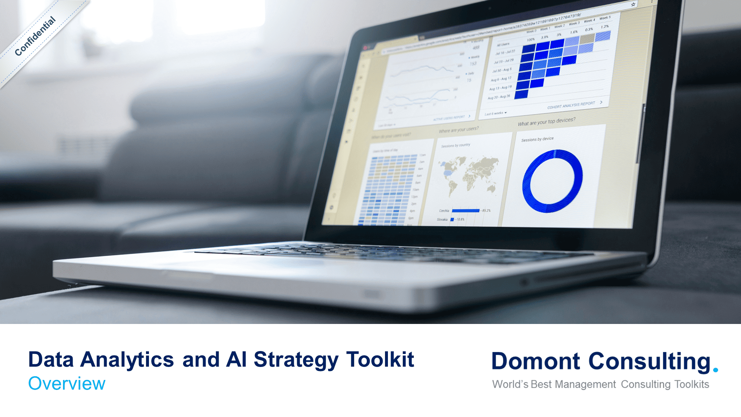
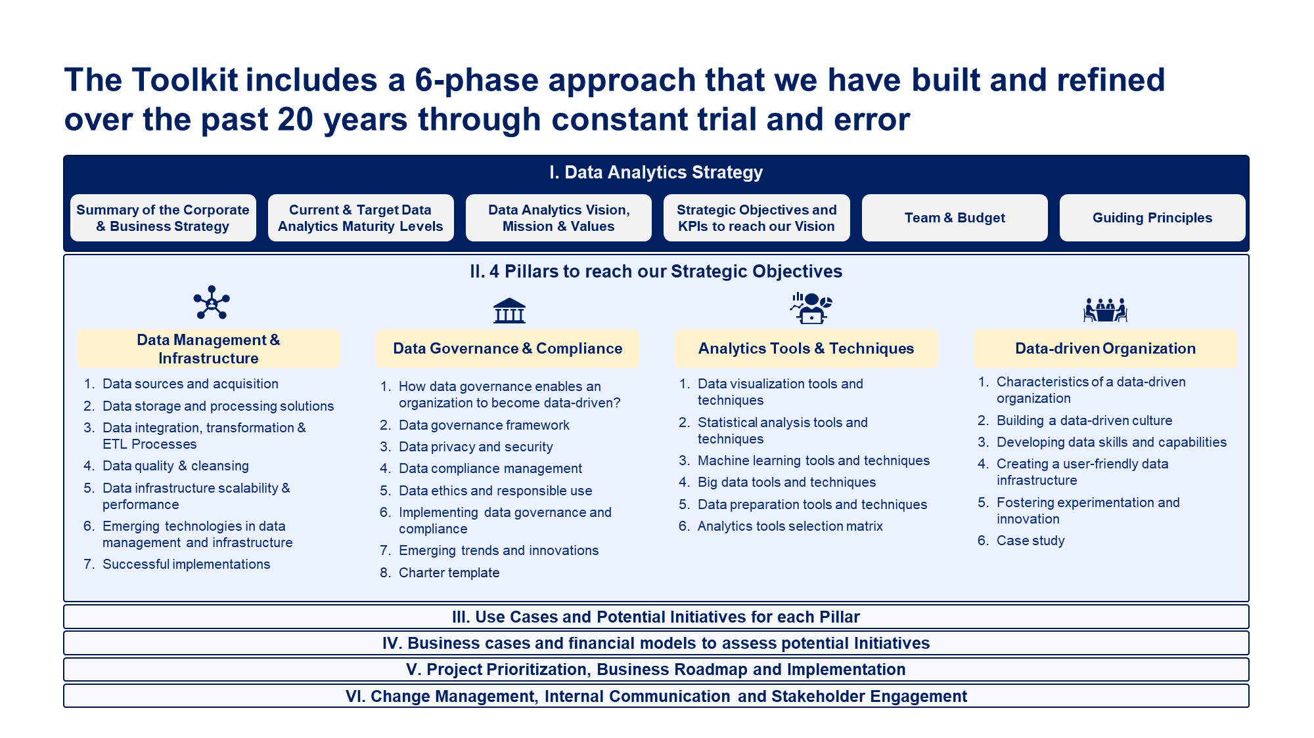
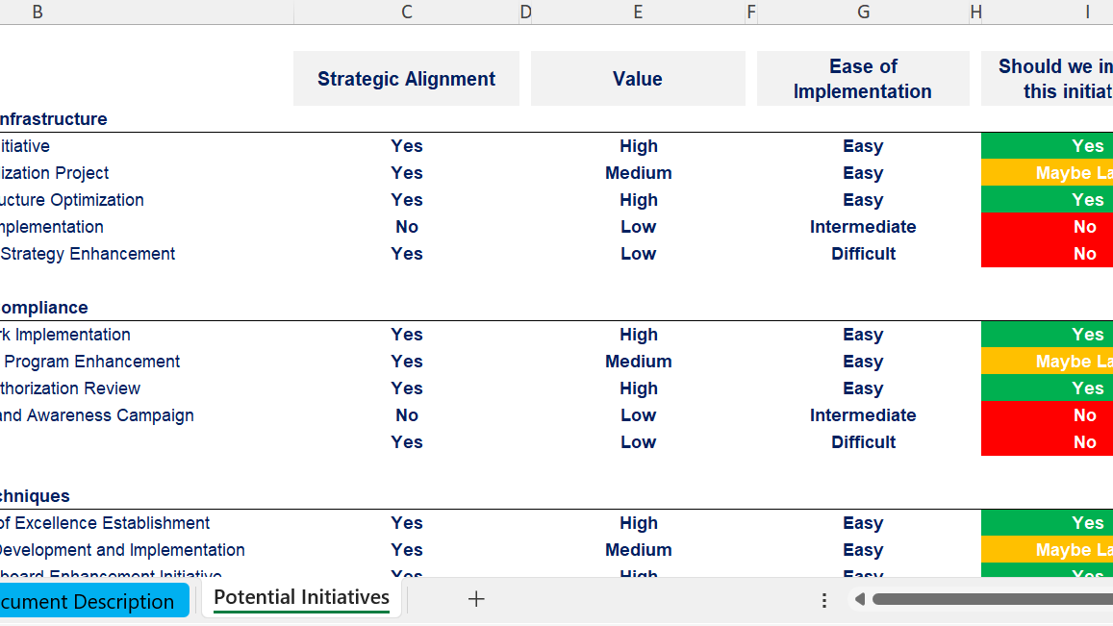
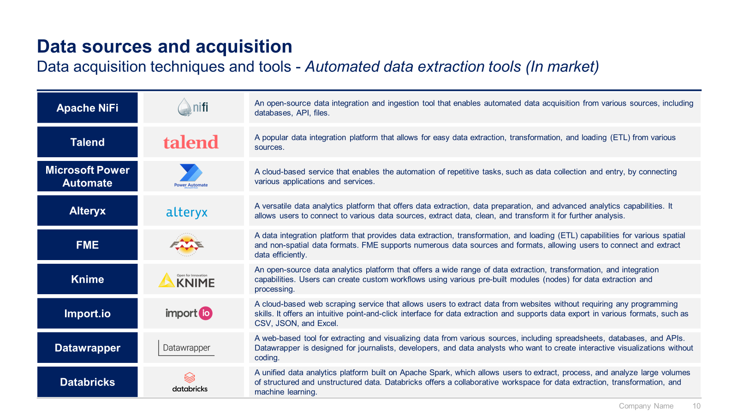
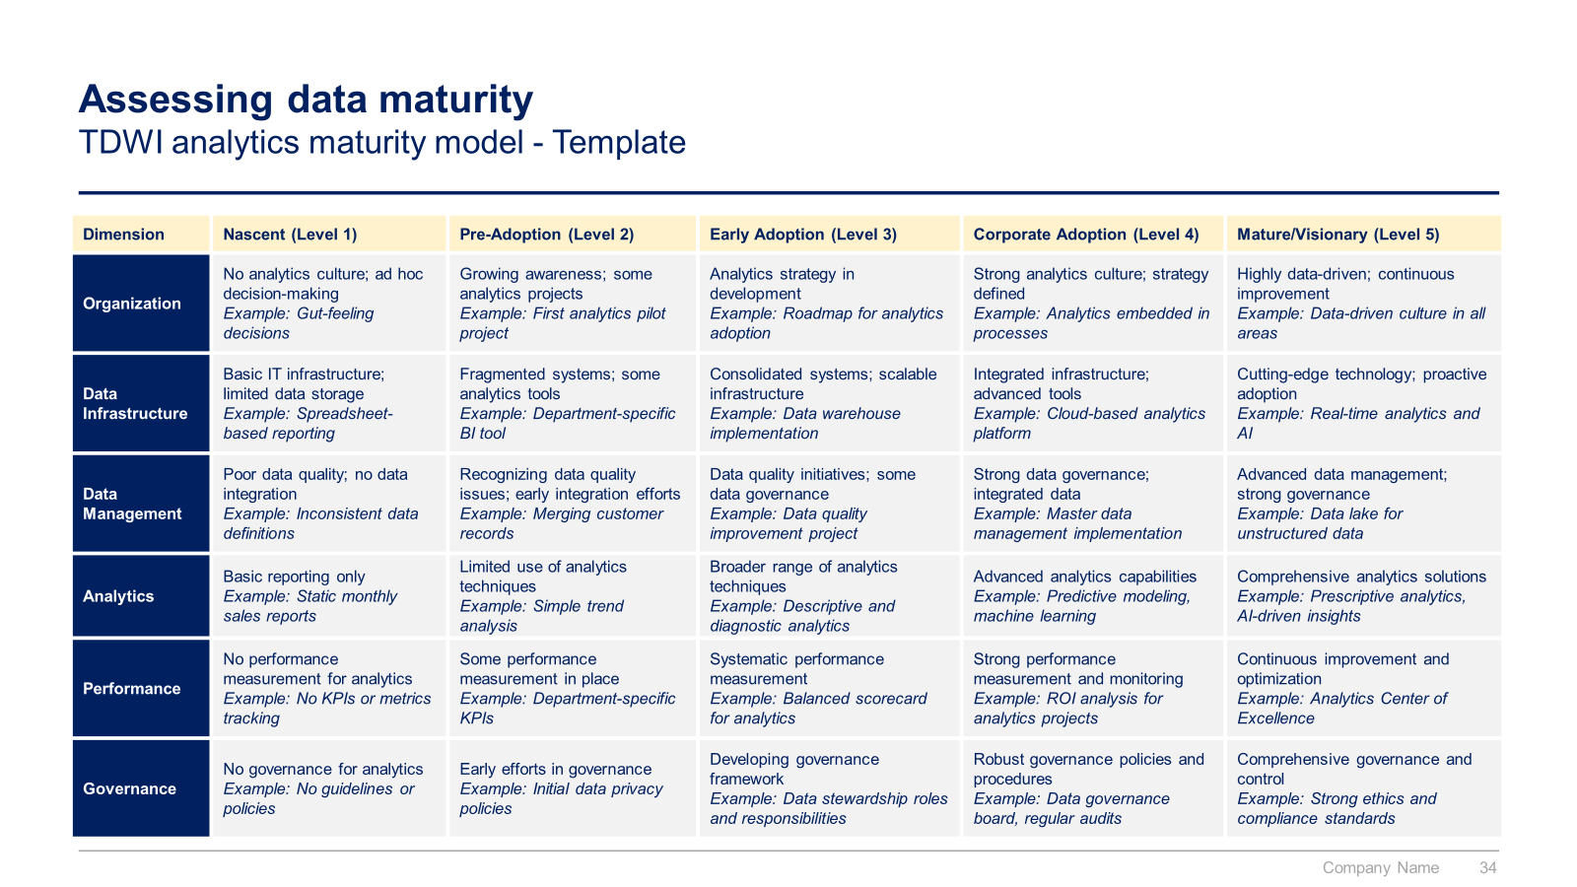
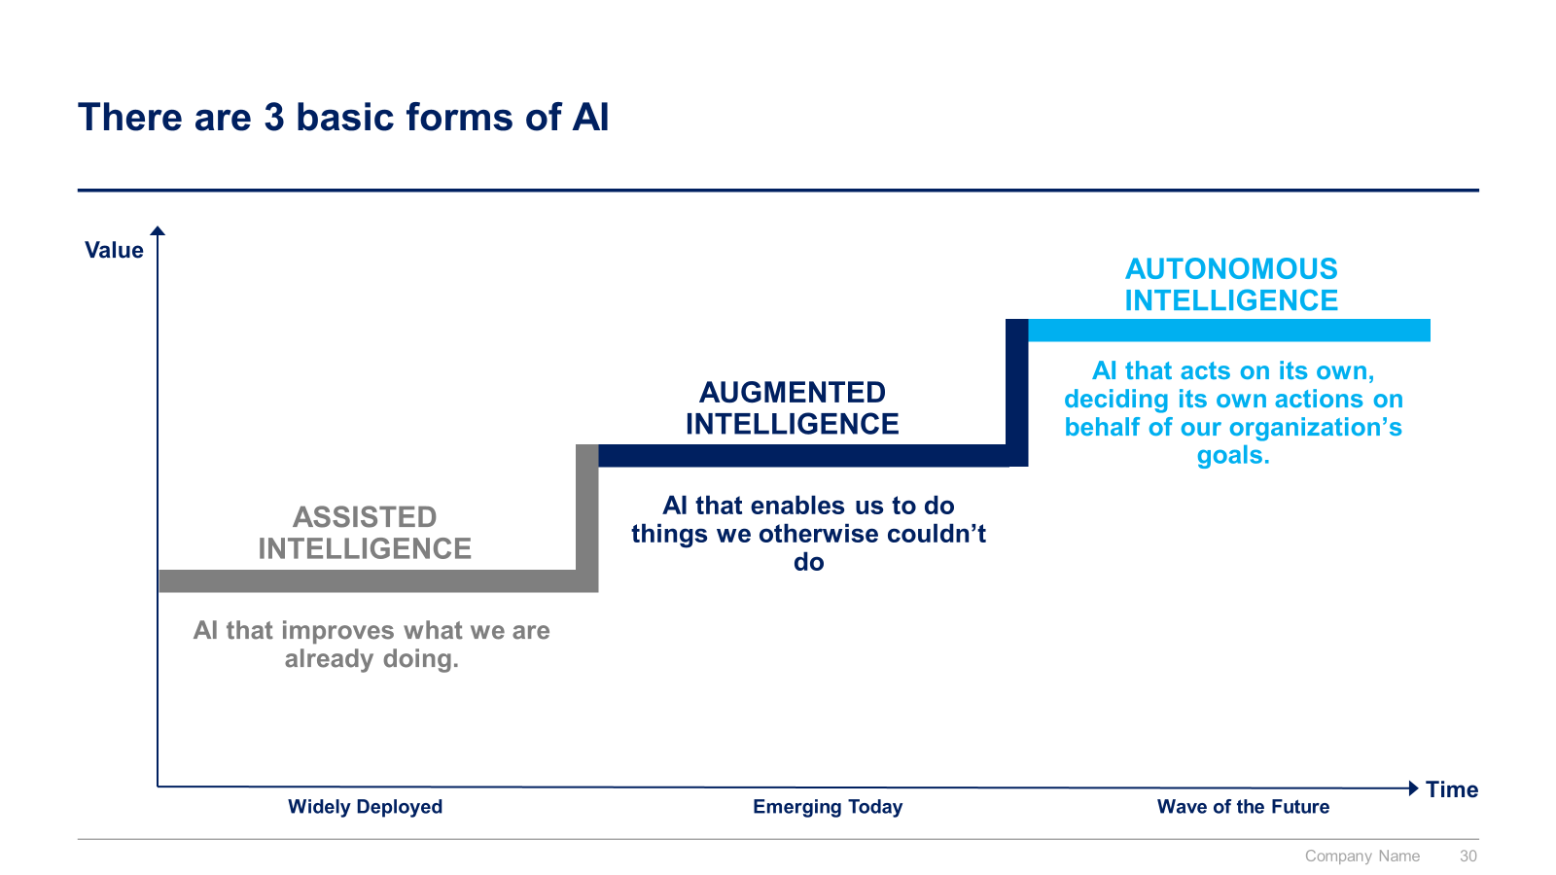
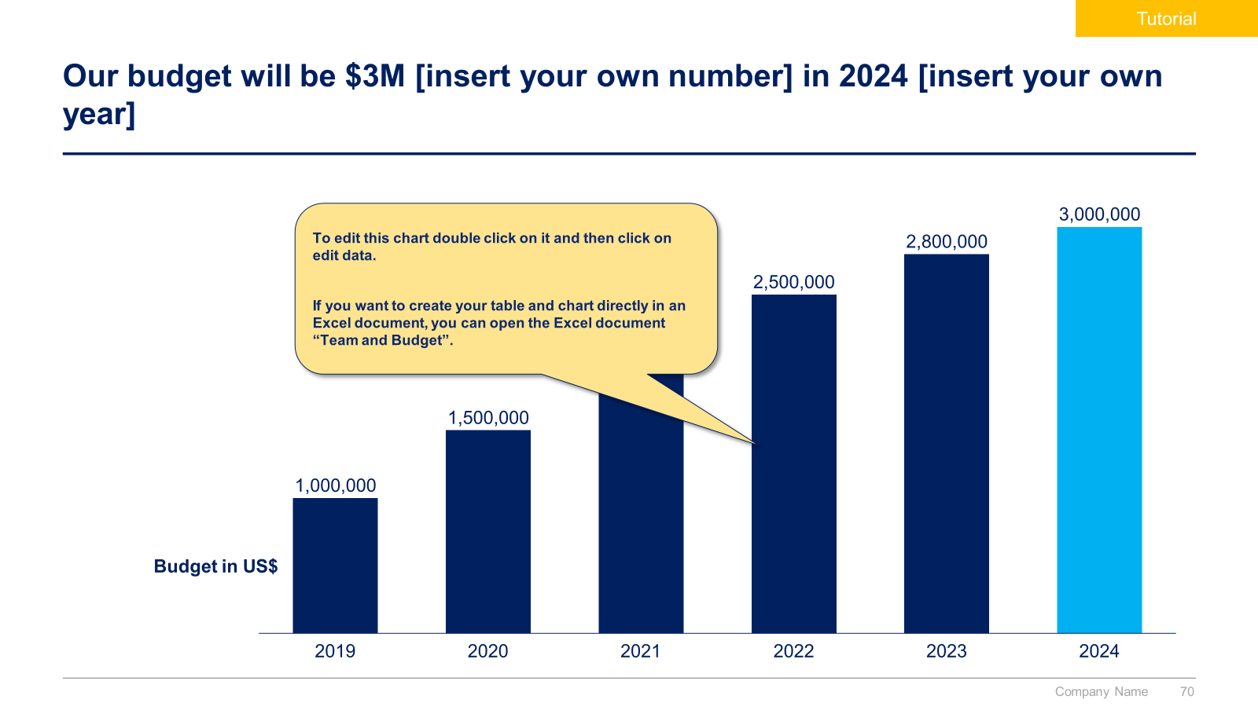
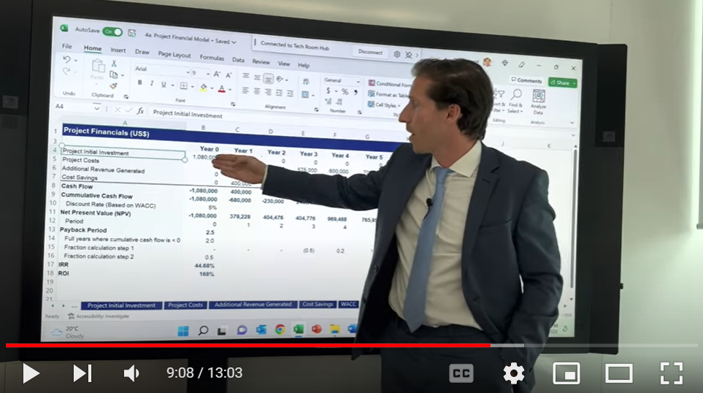
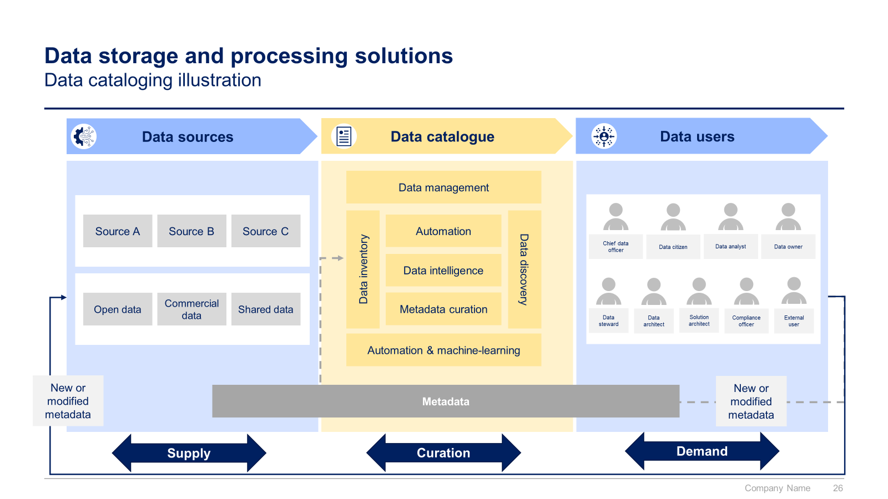

Slide 3


Introduction
This Toolkit was created by ex-McKinsey, Deloitte and BCG Management Consultants. It is considered the world's best & most comprehensive Data Analytics and AI Strategy Toolkit. It includes all the Frameworks, Best Practices & Templates required to design and implement a robust data analytics & AI strategy.
Join the 200,000+ Executives, Consultants & Entrepreneurs who are already leveraging our Management Consulting Toolkits to improve the performance of their organization and boost their own career.
If you have any questions, send us an email at support@domontconsulting.com and one of our ex-McKinsey, Deloitte & BCG Management Consultants will get back to you within 2 business days.
Aurelien Domont
Management Consultant
Domont Consulting Managing Director

Slide 4

Success stories of companies using Data Analytics By leveraging data-driven insights, Netflix has positioned itself as a leader in the streaming industry, continuously adapting and innovating to meet the evolving demands of its subscribers
One success story of a company that created a data analytics strategy is Netflix. Netflix is a global streaming service that provides a wide range of movies, TV shows, and original content to its subscribers. The company has leveraged data analytics to transform the way it operates and make informed business decisions.
Netflix collects vast amounts of data from its users, including their viewing history, search queries, ratings, and device preferences. This data is then analyzed to gain insights into user behavior, content preferences, and viewing patterns. By utilizing this information effectively, Netflix has been able to create a highly personalized and targeted user experience, ultimately leading to increased customer satisfaction and retention.
One notable example of Netflix's data analytics strategy in action is its content recommendation system. By analyzing user data, Netflix can suggest relevant movies and TV shows to individual users based on their viewing history and preferences. This personalized recommendation engine has played a significant role in attracting and retaining subscribers, as it helps users discover content they are likely to enjoy.
Furthermore, Netflix uses data analytics to make data-driven decisions in various areas of its business. For instance, the company leverages data to optimize its content acquisition strategy, identifying trends and patterns in viewer preferences to guide its content investments. This approach has allowed Netflix to produce successful original content, such as "Stranger Things" and "The Crown," by analyzing audience demand and tailoring their content offerings accordingly.
Overall, Netflix's data analytics strategy has enabled the company to understand its users better, improve its content selection, enhance the user experience, and ultimately drive business growth.

Slide 5

Success stories of companies using Data Analytics Amazon's ability to leverage data analytics effectively has played a crucial role in maintaining its competitive edge in the ever-evolving e-commerce and technology landscape
Amazon is a multinational technology company that started as an online marketplace and has since expanded into various industries, including e-commerce, cloud computing, digital streaming, and artificial intelligence.
Amazon has leveraged data analytics extensively to understand customer behavior, optimize operations, and drive business growth. One notable example is their use of data analytics in their recommendation engine. By analyzing customer browsing and purchase history, Amazon can provide personalized product recommendations to its users. This approach has significantly contributed to their success in cross-selling and upselling, as well as enhancing customer satisfaction.
Additionally, Amazon utilizes data analytics in inventory management and supply chain optimization. Through the analysis of data on historical sales, customer demand patterns, and supplier performance, Amazon can forecast future demand accurately. This enables them to optimize their inventory levels, reduce warehousing costs, and ensure efficient order fulfillment.
Another area where Amazon excels in data analytics is pricing optimization. The company analyzes vast amounts of data, including competitor prices, customer preferences, and historical sales, to dynamically adjust prices for its products. This allows Amazon to remain competitive in the market, maximize revenue, and capture demand in real-time.
Furthermore, Amazon employs data analytics in fraud detection and prevention. By analyzing customer behavior patterns, transactional data, and machine learning algorithms, Amazon can identify and mitigate fraudulent activities such as unauthorized account access, fake reviews, and suspicious transactions. This helps protect both customers and the integrity of the platform.
Overall, Amazon's data analytics strategy has been instrumental in its success as a technology giant. By harnessing the power of data, the company continuously improves customer experiences, optimizes operations, and drives innovation.

Slide 6

Success stories of companies using AI Alphabet, Google’s parent company, has successfully leveraged AI in projects like RankBrain for improved search results and AlphaFold for accurate protein structure prediction
One of Alphabet's most notable AI-driven innovations is Google's RankBrain, a machine learning system that plays a crucial role in the company's search algorithm. Introduced in 2015, RankBrain helps Google understand and process complex search queries more effectively. By analyzing user behavior and patterns, RankBrain learns to deliver more relevant search results. The implementation of RankBrain has significantly improved the accuracy and quality of Google's search results, enhancing the user experience and solidifying Google's position as the world's leading search engine.
Another groundbreaking stride in the field of AI research by Alphabet is DeepMind's AlphaFold, an AI system designed to predict protein structures. Proteins play a vital role in biological processes, and understanding their structures is crucial for drug discovery and disease treatment. AlphaFold has demonstrated remarkable accuracy in predicting protein structures, surpassing traditional computational methods. The implications of AlphaFold's success are far-reaching, as it has the potential to accelerate research in biology, medicine, and related fields.
These success stories showcase Alphabet's commitment to pushing the boundaries of AI innovation. Their AI projects have the potential to revolutionize industries like telecommunications, visual search, and autonomous transportation, demonstrating the vast scope and impact of Alphabet's AI initiatives.

Slide 7

Success stories of companies using AI OpenAI, with its AI model ChatGPT, has achieved significant success, leading to a multibillion-dollar deal with Microsoft and an alliance with Bain
OpenAI, founded in 2015, has made significant strides in the field of artificial intelligence (AI). It started as a non-profit with the goal of building artificial general intelligence (AGI) — an AI that could perform most jobs better than a human. Over the years, OpenAI's pursuit of AGI led to the development of the viral chatbot, ChatGPT.
ChatGPT, launched with zero fanfare in late November 2022, quickly became a viral mega-hit. It was viewed in-house as a “research preview,” a tease of a more polished version of a two-year-old technology. The success of ChatGPT took OpenAI by surprise, and the firm has been scrambling to catch up—and capitalize on its success—ever since.
OpenAI has updated ChatGPT several times since its launch. The researchers are using a technique called adversarial training to stop ChatGPT from letting users trick it into behaving badly. This work pits multiple chatbots against each other: one chatbot plays the adversary and attacks another chatbot by generating text to force it to buck its usual constraints and produce unwanted responses.
OpenAI has also signed a multibillion-dollar deal with Microsoft and announced an alliance with Bain, a global management consulting firm, which plans to use OpenAI’s generative AI models in marketing campaigns for its clients, including Coca-Cola. The buzz about ChatGPT has set off yet another gold rush around large language models, with companies and investors worldwide getting into the action.

Slide 8












Our firm created a Data Analytics and AI Strategy Toolkit to help you create your own success stories
What’s inside the Toolkit?
Who created the Toolkit?
The Toolkit was created ex-McKinsey, Deloitte and BCG Management Consultants.
Best Practices
Frameworks
Number of professionals leveraging our Toolkits
Advice from
tier-1 Management Consultants
Tools
There are 200,000+ Executives, Consultants & Entrepreneurs leveraging our Toolkits to improve the performance of their organization
Real-life Examples
Templates
Trusted by small and large organizations
Video Training
Step-by-step Tutorials

Slide 9
Our Toolkit will help you fulfill multiple objectives
The Data Analytics and AI Strategy Toolkit includes frameworks, tools, templates, tutorials, real-life examples, video training, and best practices to help you:
Define and implement your Data Analytics Strategy: (1) Summary of the Corporate & Business Strategy, (2) Current & Target Data Analytics Maturity Levels, (3) Data Analytics Vision, Mission & Values, (4) Strategic Objectives and KPIs to reach our Vision, (5) Team & Budget, (6) Guiding Principles
Define and implement your AI Strategy: (1) Summary of the Corporate & Business Strategy, (2) AI Essentials, (3) Current & Target AI Maturity Levels, (4) AI Vision, Mission & Values, (5) Strategic Objectives and KPIs to reach our Vision, (6) Team & Budget, (7) Guiding Principles
Build your 4 pillars to reach your Data Analytics Strategic Objectives: (1) Data Management & Infrastructure, (2) Data Governance & Compliance, (3) Analytics Tools & Techniques, (4) Data-driven Organization
Identify the key Technologies to enable your AI Strategy: (1) AI data center, (2) Machine Learning, (3) Deep Learning, (4) Generative AI Chatbots, NLP & Prompt Engineering, (5) Artificial General Intelligence, (6) Cloud Computing
Identify Use Cases and Potential Initiatives in Data Analytics and AI
List your potential initiatives in Data Analytics and AI
Create your business cases and financial models to assess potential initiatives
Prioritize, plan and implement your projects: (1) Project prioritization, (2) Business roadmap, (3) Governance, (4) Dashboards, (5) Project implementation: agile methodology, design thinking and traditional methodology, (6) Continuous improvement (7) Post program/projects evaluation and lessons learnt
Define and implement your change management strategy, internal communication strategy, and stakeholder engagement strategy: (1) Change management strategy, (2) Change management plans, (3) Implementation, tracking and progress management, (4) Effective communication

Slide 10

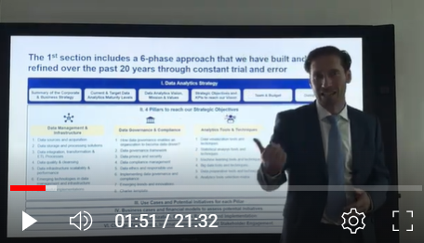
Video demonstration of the Toolkit
Video Demo Access
Video Demo Visual
Select “Slide Show” mode and then click on the link below or on the image on the right to access this video demo.
You can also access the video by copy pasting the following URL in your browser:
https://youtu.be/fC7LP6hV1fg

Slide 11
The Toolkit includes 2 sections
1
Data Analytics
2
AI

Slide 12

The 1st section includes a 6-phase approach that we have built and refined over the past 20 years through constant trial and error
I. Data Analytics Strategy
Summary of the Corporate & Business Strategy
Current & Target Data Analytics Maturity Levels
Data Analytics Vision, Mission & Values
Strategic Objectives and KPIs to reach our Vision
Team & Budget
Guiding Principles
II. 4 Pillars to reach our Strategic Objectives
Data Management & Infrastructure
Data Governance & Compliance
Analytics Tools & Techniques
Data-driven Organization
Data sources and acquisition
Data storage and processing solutions
Data integration, transformation & ETL Processes
Data quality & cleansing
Data infrastructure scalability & performance
Emerging technologies in data management and infrastructure
Successful implementations
How data governance enables an organization to become data-driven?
Data governance framework
Data privacy and security
Data compliance management
Data ethics and responsible use
Implementing data governance and compliance
Emerging trends and innovations
Charter template
Data visualization tools and techniques
Statistical analysis tools and techniques
Machine learning tools and techniques
Big data tools and techniques
Data preparation tools and techniques
Analytics tools selection matrix
Characteristics of a data-driven organization
Building a data-driven culture
Developing data skills and capabilities
Creating a user-friendly data infrastructure
Fostering experimentation and innovation
Case study
III. Use Cases and Potential Initiatives for each Pillar
IV. Business cases and financial models to assess potential Initiatives
V. Project Prioritization, Business Roadmap and Implementation
VI. Change Management, Internal Communication and Stakeholder Engagement

Slide 13
The 2nd section includes a 6-phase approach that we have built and refined over the past 10 years through constant trial and error
I. AI Strategy
Summary of the Corporate & Business Strategy
AI Essentials
Current & Target AI Maturity Levels
AI Vision, Mission & Values
Strategic Objectives and KPIs to reach our Vision
AI Team & Budget
AI Guiding Principles
II. Key Technologies to enable our AI Strategy
AI data center
Machine Learning
Deep Learning
Generative AI, Chatbots, NLP & Prompt Engineering
Artificial General Intelligence (AGI)
Cloud Computing
III. Potential Use Cases & Initiatives to reach our Strategic Objectives
Corporate and Business Strategy function
Sales function
Marketing function
Supply Chain function
Customer Service function
HR function
Data Analytics function
Finance function
IT function
Legal and Compliance function
IV. Business Cases and Financial Models to assess potential Use Cases & Initiatives
V. Project Prioritization, Business Roadmap and Implementation
VI. Change Management, Internal Communication and Stakeholder Engagement

Slide 14
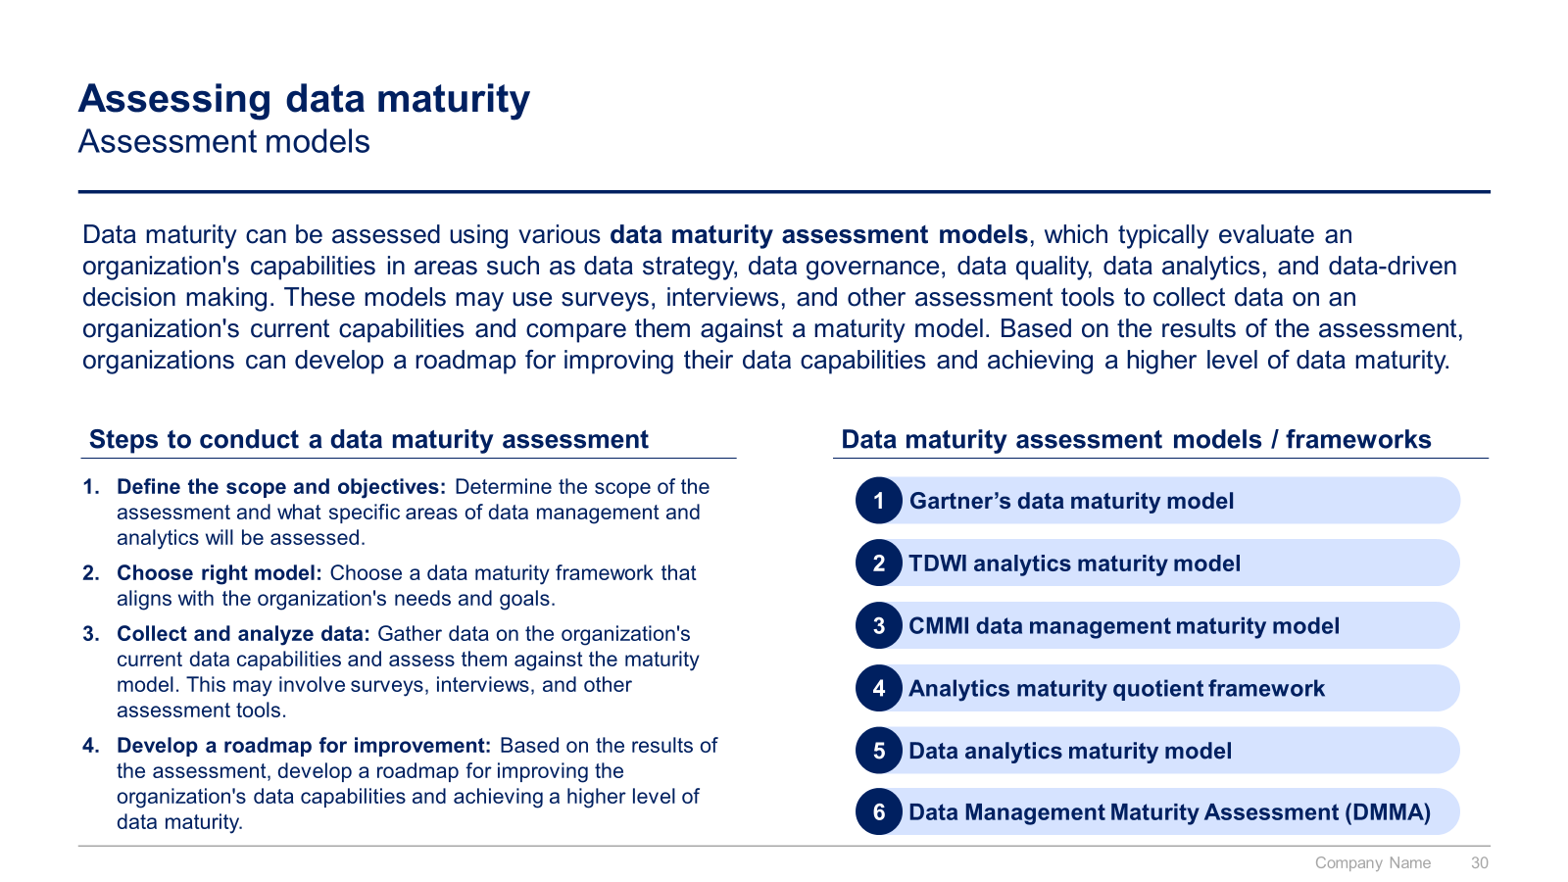
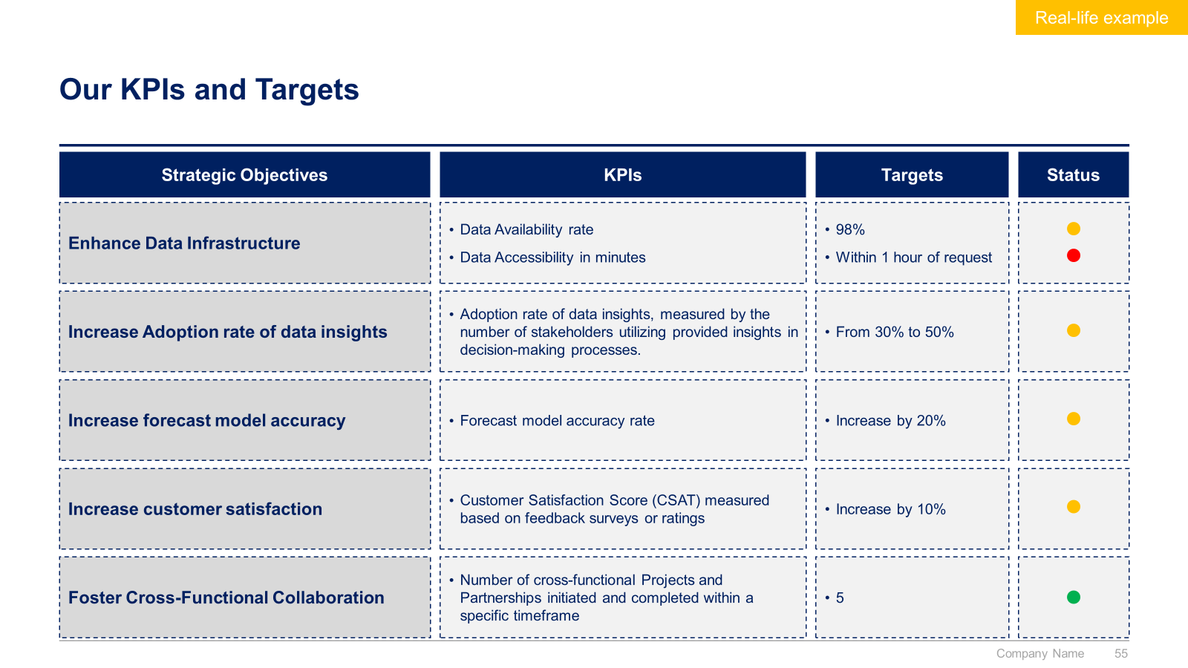
Small preview of the Data Analytics section (1/3)

Slide 15
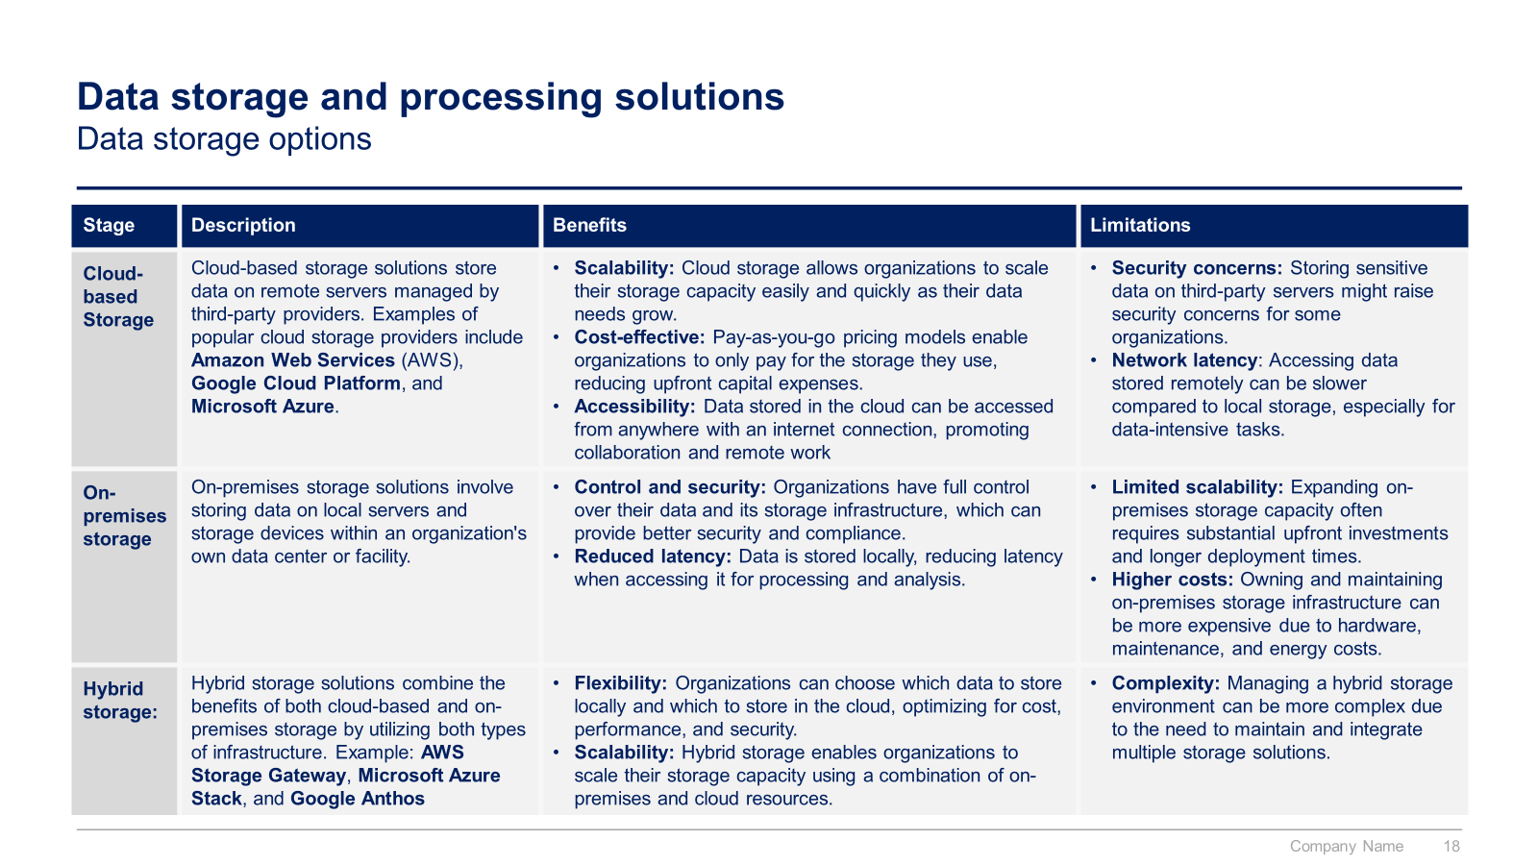
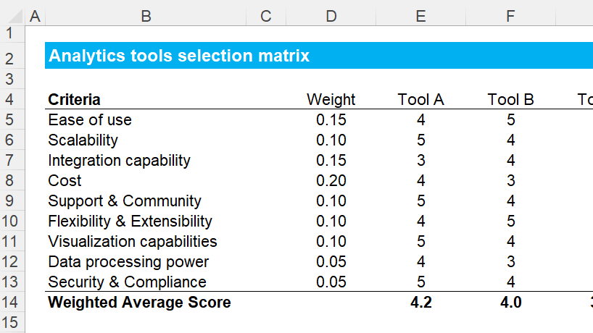
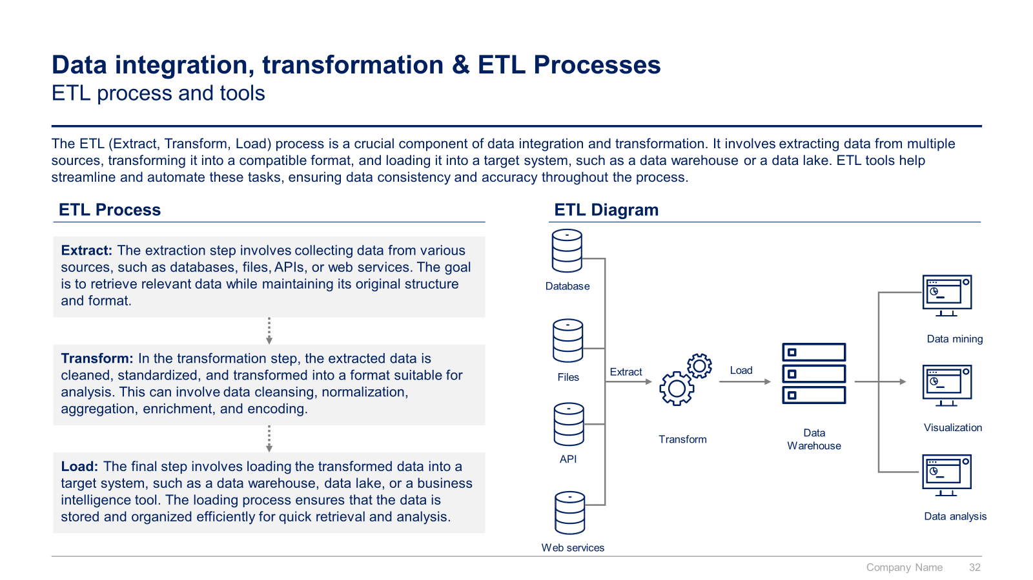
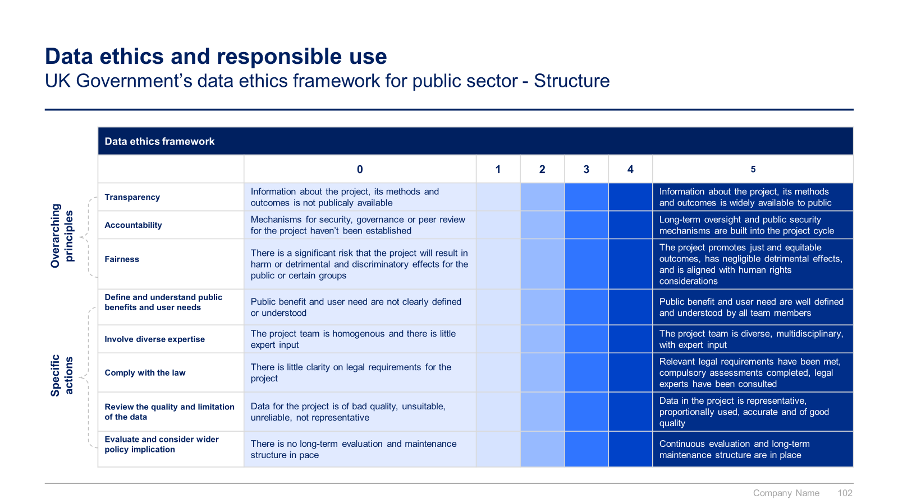
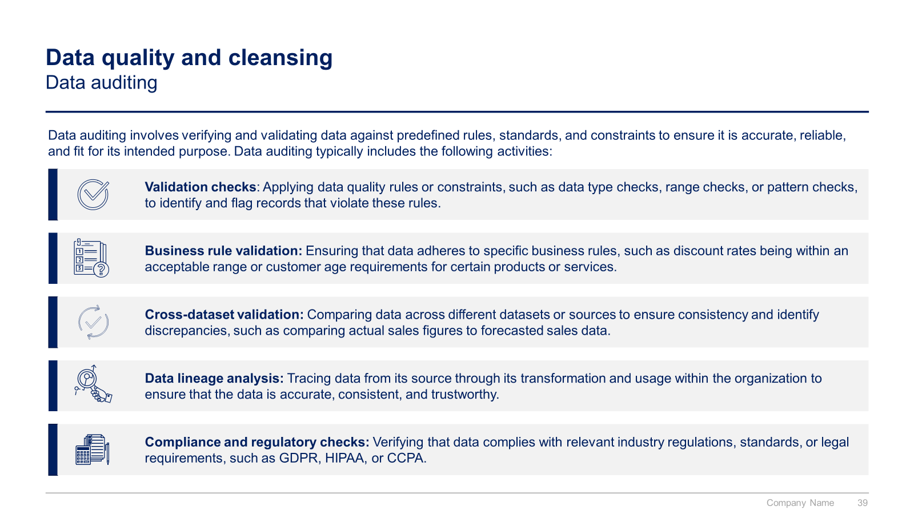
Small preview of the Data Analytics section (2/3)

Slide 16
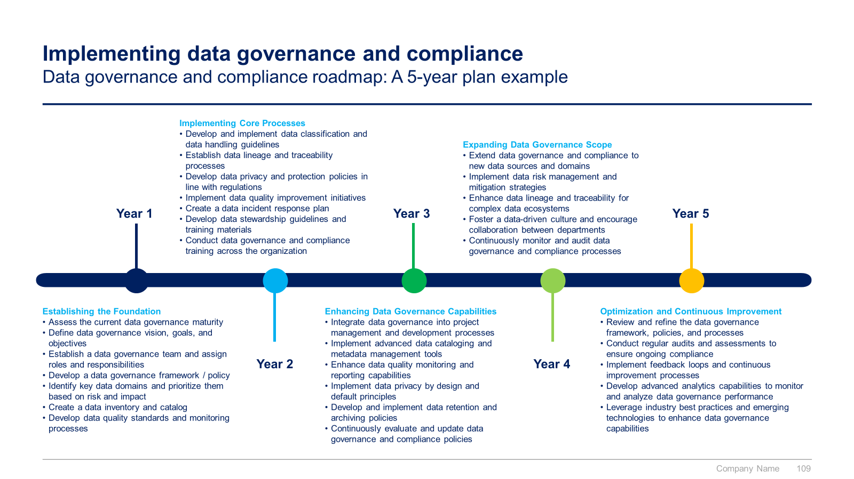
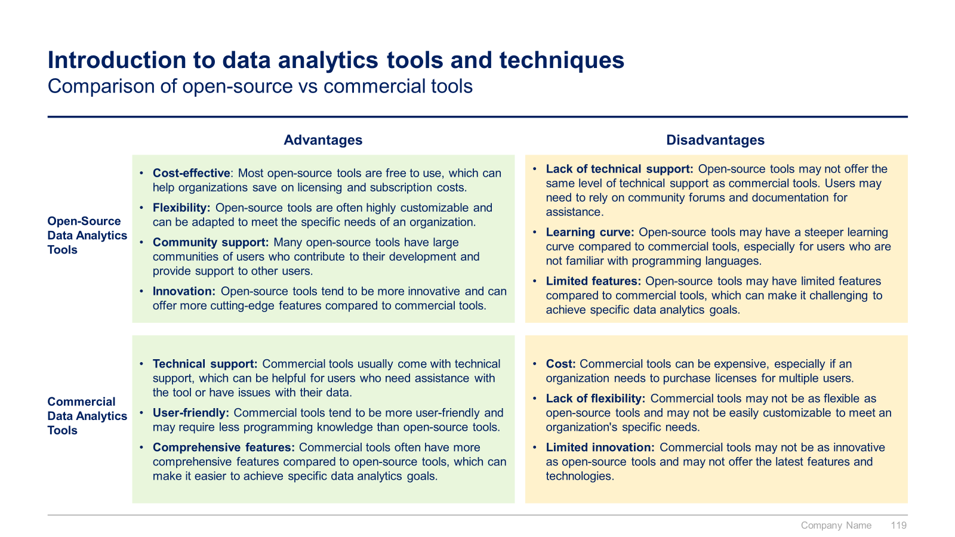
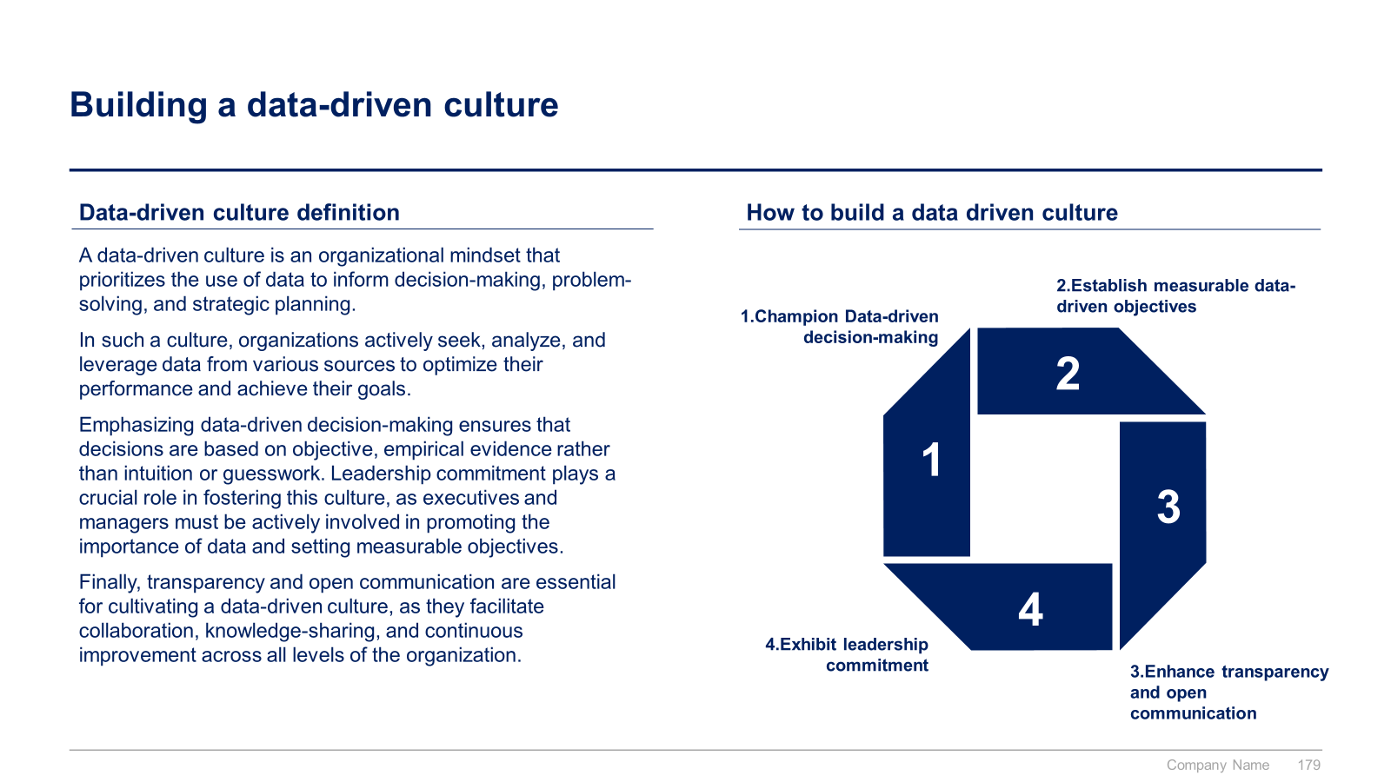
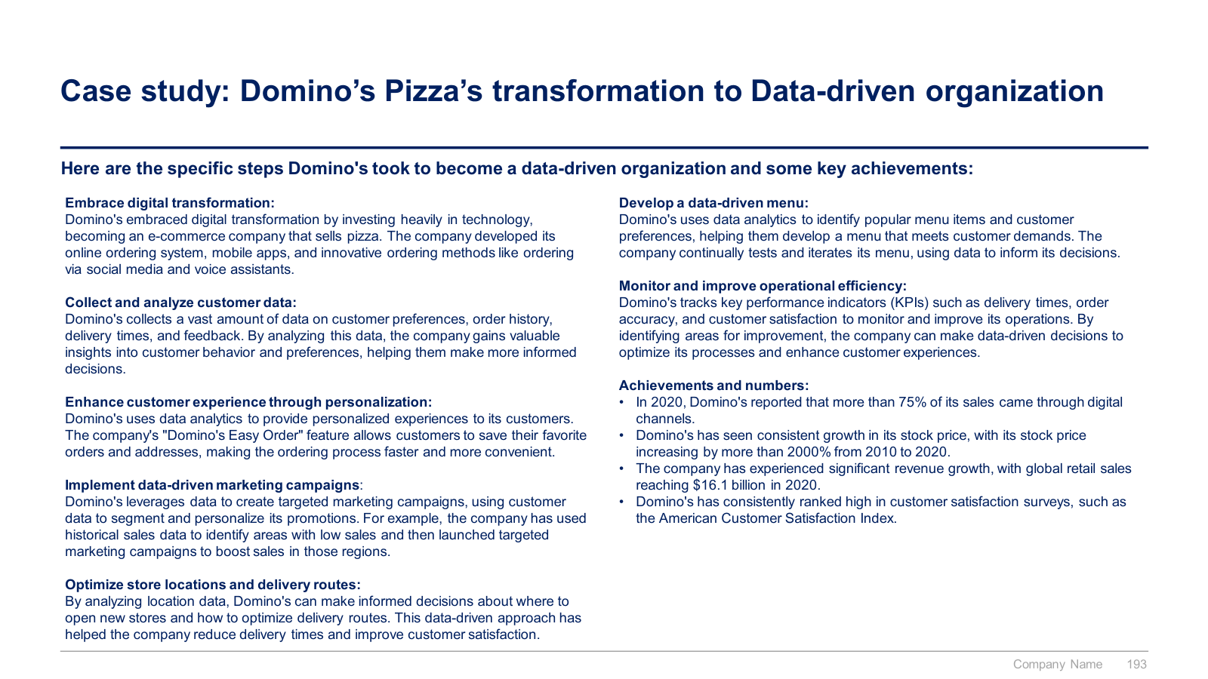
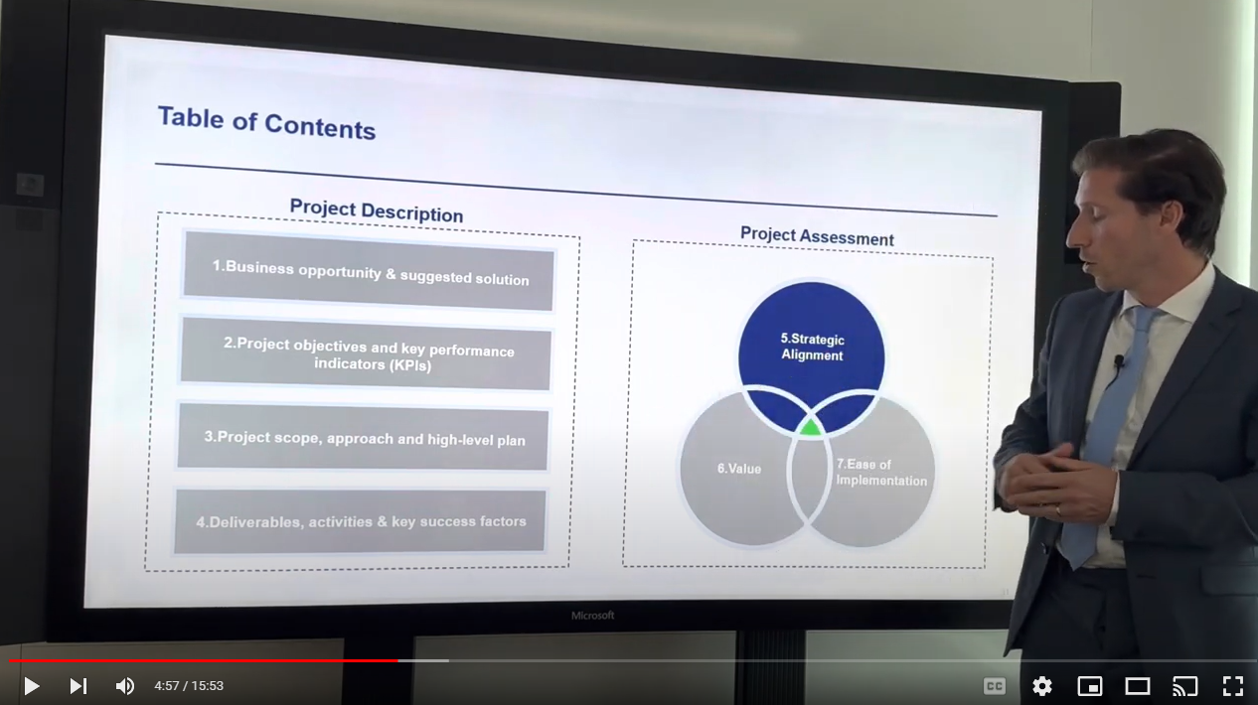
Small preview of the Data Analytics section (3/3)

Slide 17
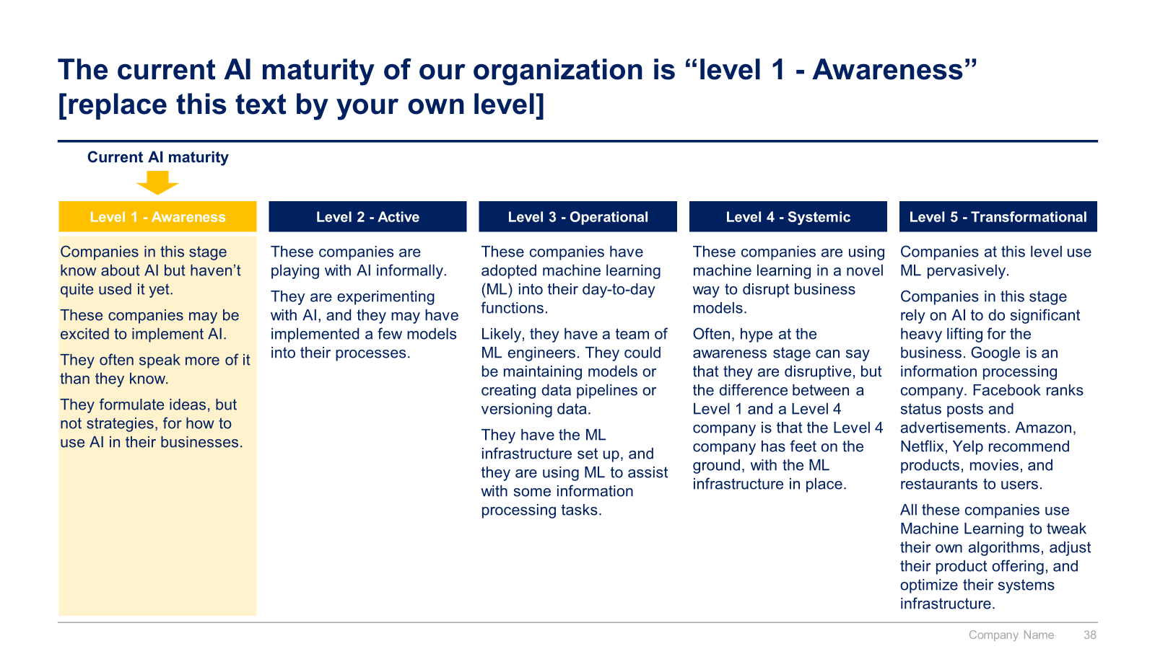
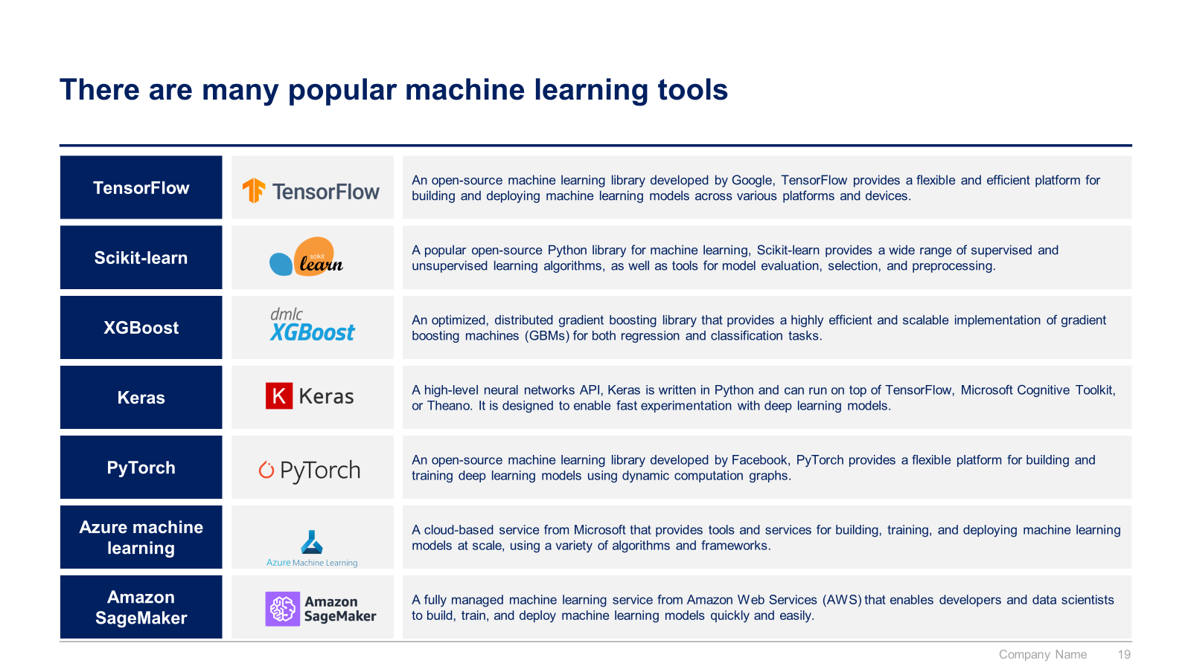
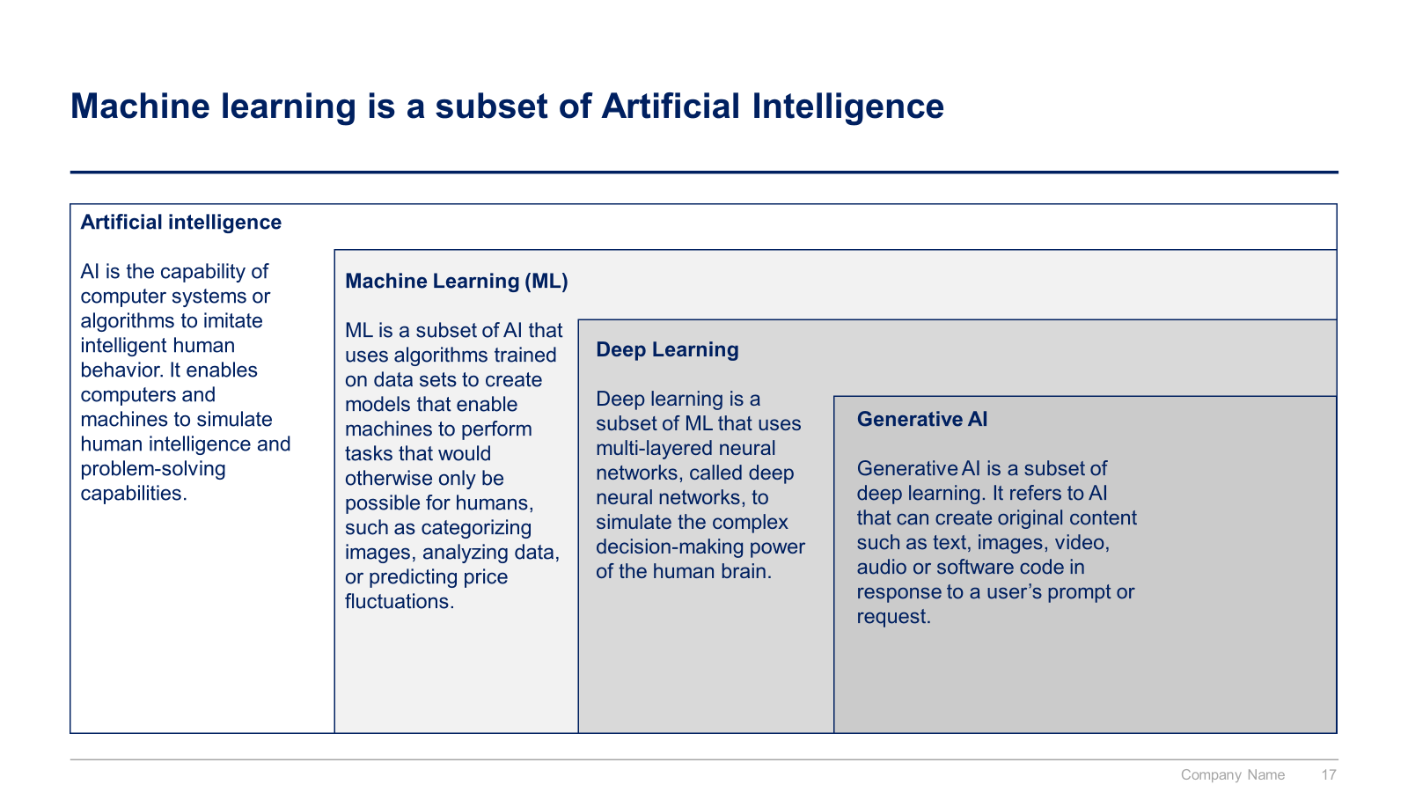
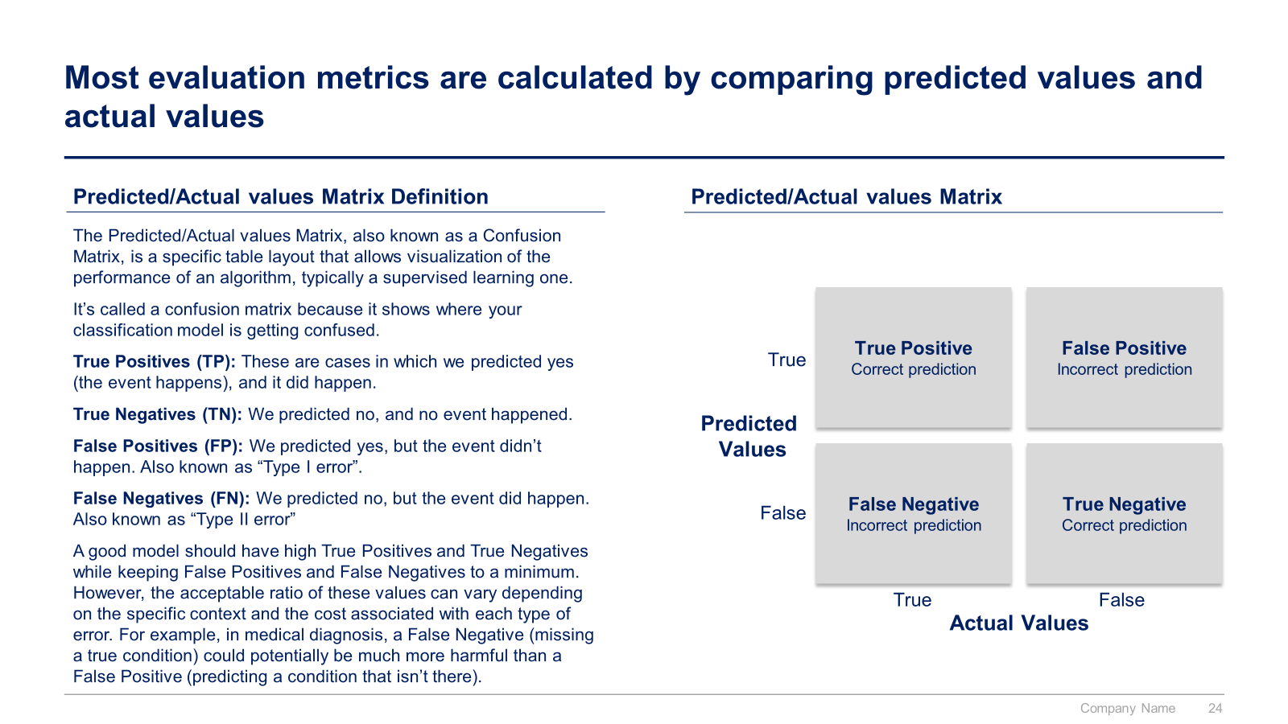
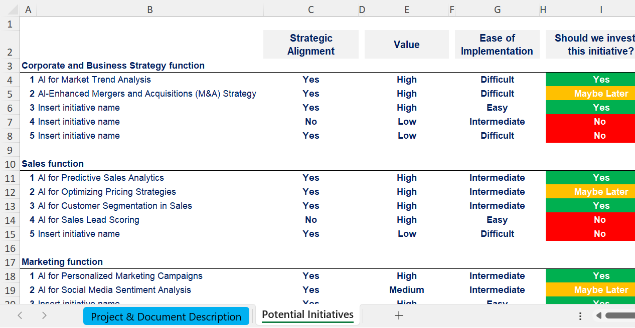
Small preview of the AI section (1/2)

Slide 18
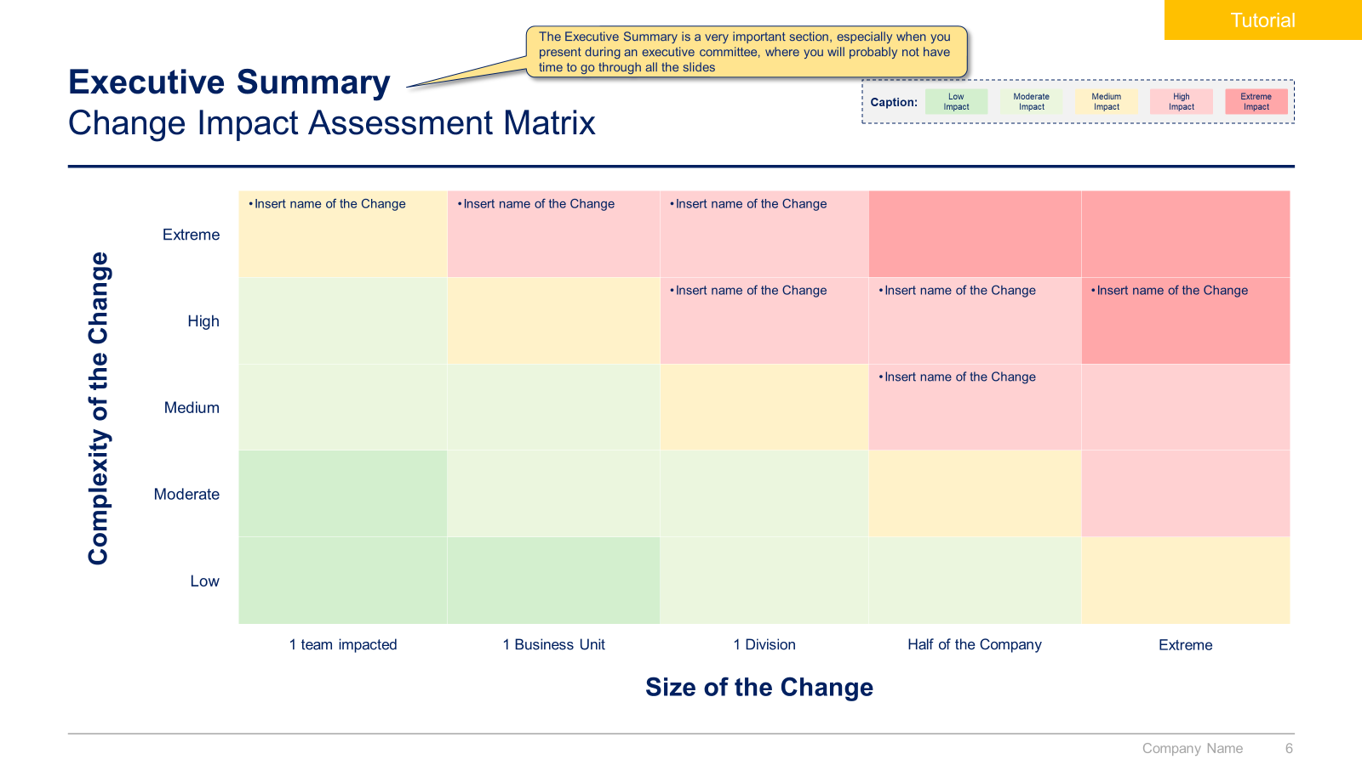
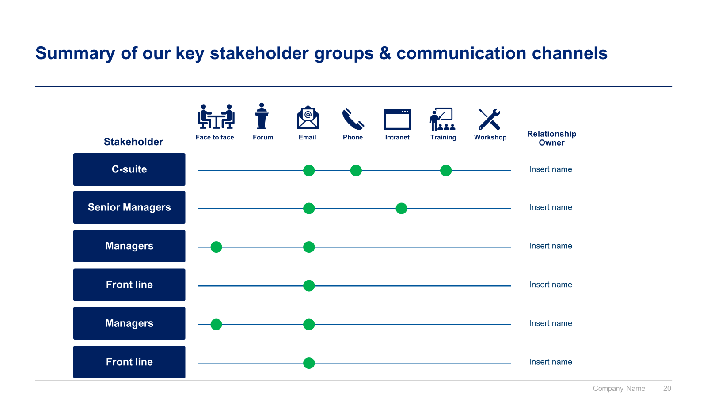
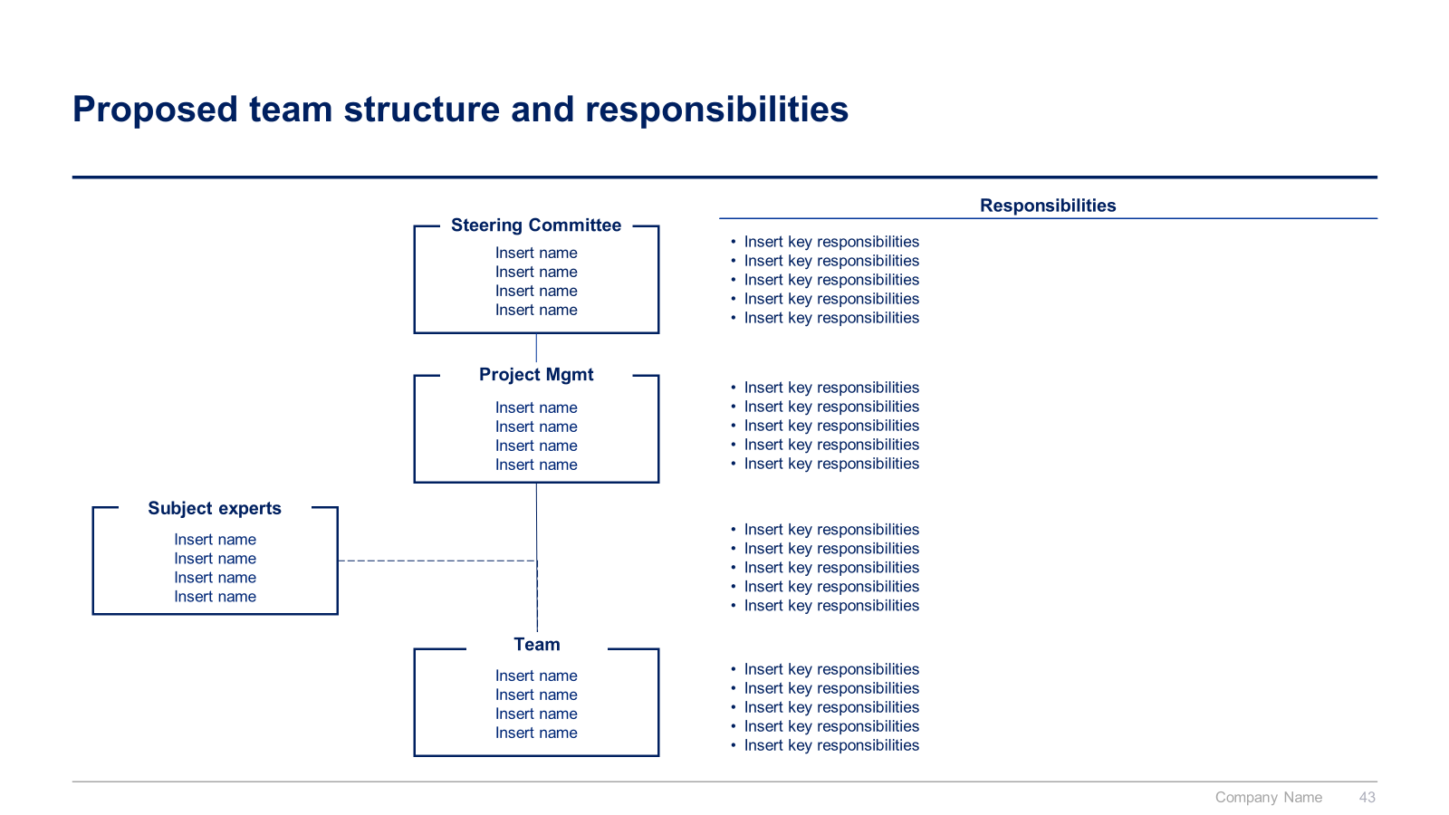
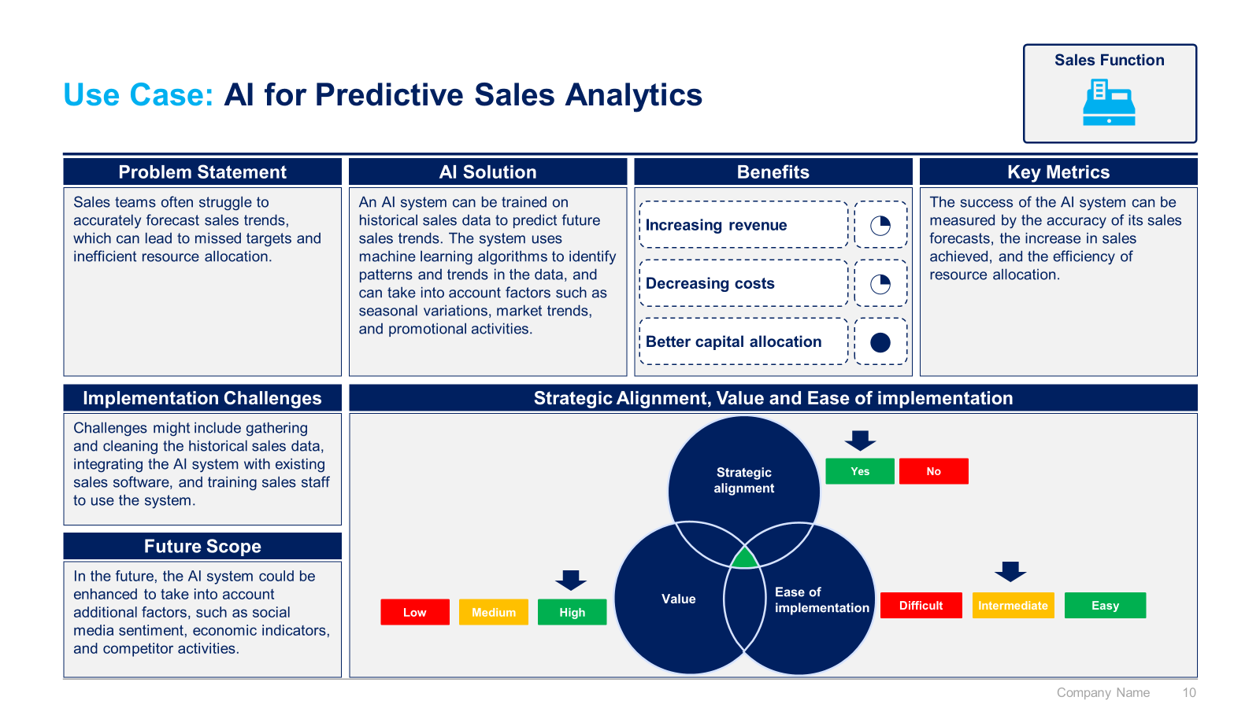
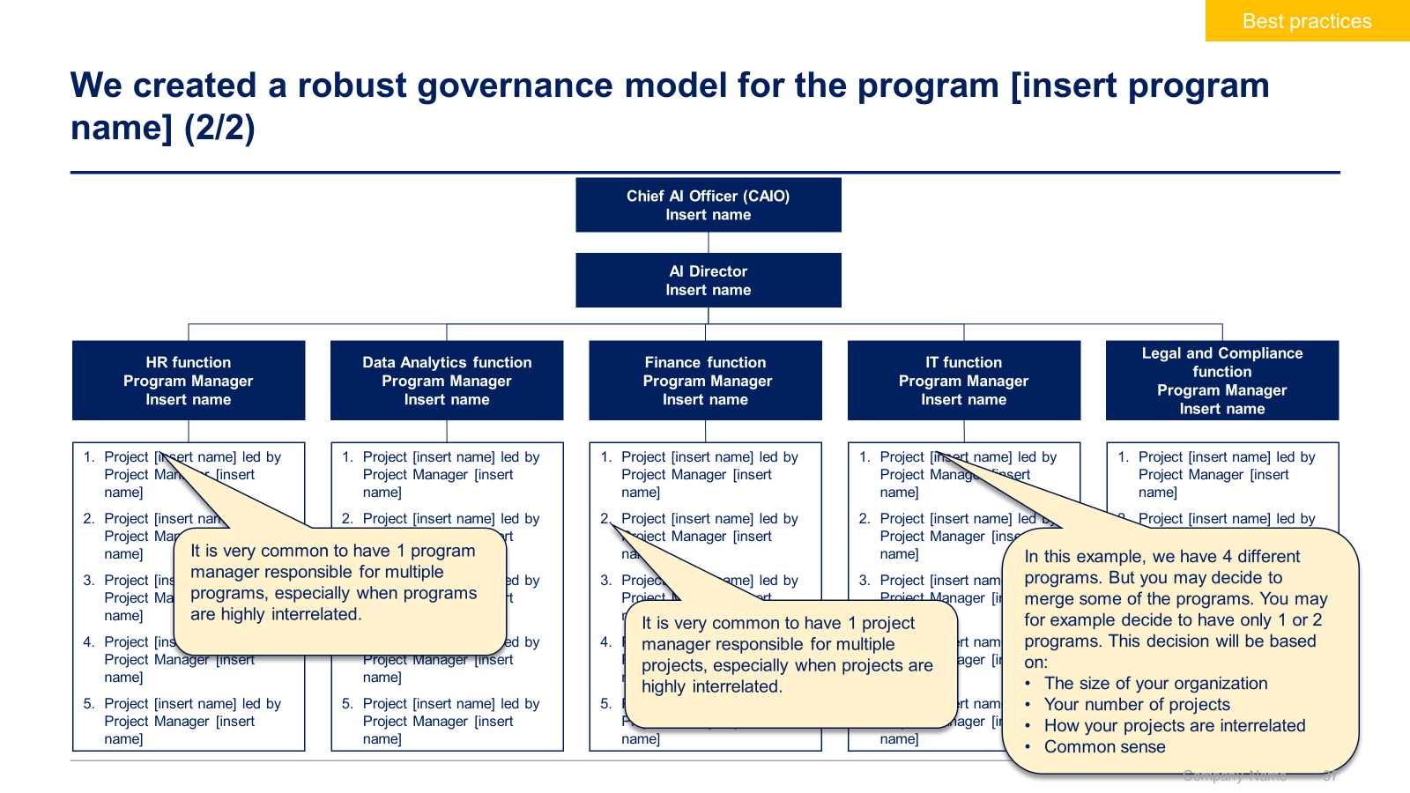
Small preview of the AI section (2/2)

Slide 19



The Toolkit includes multiple PowerPoint slides, Excel sheets and Video training that you can download on your device immediately after purchase
700 editable PowerPoint slides*
40 Excel sheets*
65 minutes of Video training
Overview and Approach
Data Analytics
AI
*Please note that the number of Powerpoint slides and Excel sheets listed is the number of unique slides and sheets. For example, a Powerpoint slide that has been duplicated to facilitate our clients’ understanding only counts for one slide

Slide 20









Our Management Consulting Toolkits include 9 key benefits
Improve the growth & efficiency of your organization by leveraging Management Consulting Toolkits created by ex-McKinsey, Deloitte & BCG Consultants.
Make a great investment for your career & organization. It cost us US$8M+ over the past 10 years to create all our Toolkits. Get them for a fraction of this cost.
Get a competitive advantage. It’s like hiring Management Consultants to create all the practical Frameworks, Tools & Templates you need.
Get the job done quicker and never start from scratch again with our ready-made and fully editable Frameworks, Tools & Templates in Powerpoint & Excel.
Don't reinvent the wheel. We have already worked 30,000+ hours over the past 10 years to create all the Management Consulting Toolkits you need.
Improve the capabilities of your organization by learning how the Fortune 100 and Global Consulting Firms do it.
Decrease your costs. Hiring tier-1 Consultants for a project would cost you $300k+. Way more expensive than our Toolkits, which will last you a lifetime!
Become your organization’s subject matter expert and impress your stakeholders with world-class approaches to resolve common business problems.
Get free support and advice from our ex-McKinsey, Deloitte & BCG Management Consultants.

Slide 21
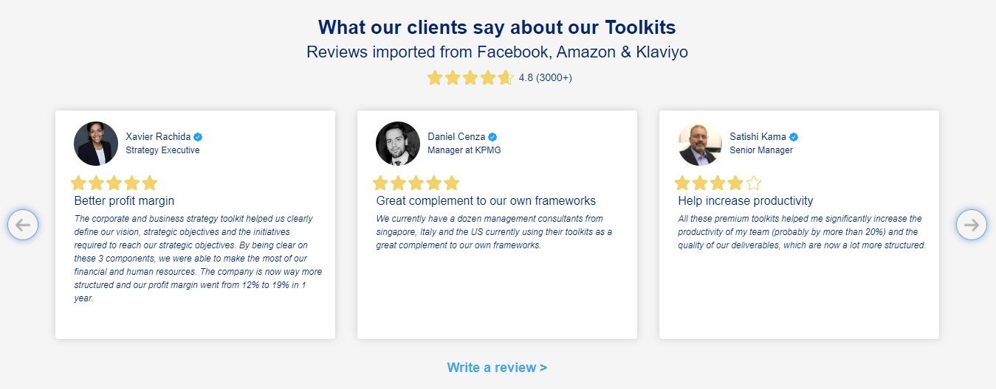
What our clients say about our Toolkits
Click here to see more reviews >

Slide 22

Join 200,000+ Executives, Consultants & Entrepreneurs leveraging our Toolkits to improve the performance of their organization
Trusted by small and large organizations
Customer satisfaction
4.8
Number of countries leveraging our Toolkits
160+
Number of professionals leveraging our Toolkits
200,000+
Daily rate of our ex-McKinsey, Deloitte and BCG Management Consultants
$3k-$4k

Slide 23

Interested in more than 1 Toolkit? Access all our Toolkits for half the price with our Gold Access
Gold Access
Click here to learn more

Slide 24


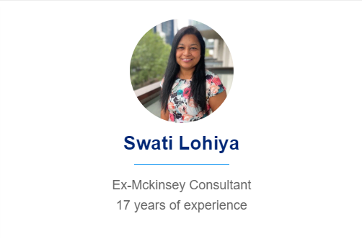


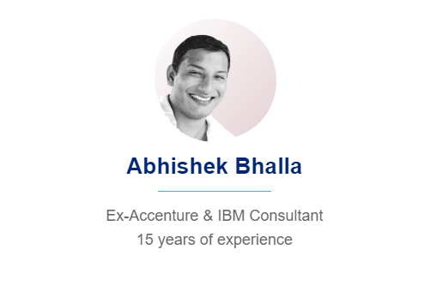
Need additional help? Send us a brief and we’ll find you the right talent from our network of 500+ tier-1 Management Consultants
Click here to send us a Project Brief

Slide 25

This was just a small preview.
www.domontconsulting.com

